Slide 1

Expense Tracker

Slide 2
Introduction
This project introduces a personal expense tracker application designed to simplify personal finance management.
This application allows users to easily
Record their income and expenses
Categorize transactions
Generate insightful reports
Set budgeting goals

Slide 3

Features of the website
This expense tracker website offers a comprehensive suite of features designed to simplify financial management.
These features includes:
1. Users authentication and security protocol
It is the cornerstone of any responsible expense tracker website.it is not just about logging in; it is about ensuring your financial data id completely safe and inaccessible to an authorized individuals.

Slide 4
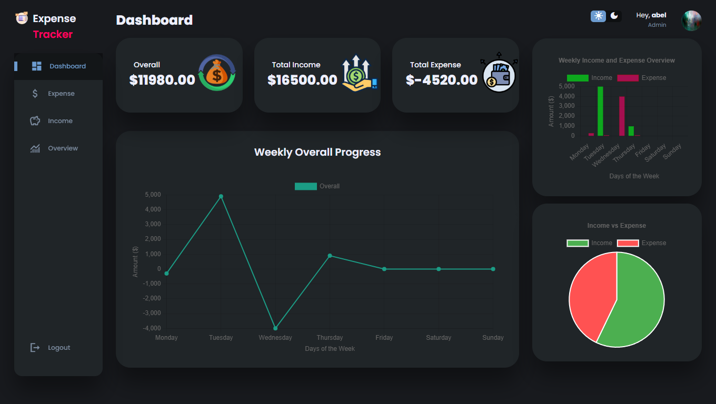
2. Dashboard and Data Visualization
This feature transforms raw expense data into actionable insights. It is the heart of the expense tracker, providing a user-friendly interface to understand your
financial situation at a glance. This feature typically encompasses:
A. Dashboard overview: this if the first screen you see after logging in. It provides a good summary of your finance. Key information includes:
-total income
-total expense
-net income/balance (income-expense)
-budget summary

Slide 5
B. Weekly breakdown
This feature allows you to search deeper into your spending habits on a weekly basis. It present information like:
weekly spending trend
spending by categories (weekly)
C. Data representation chart and graph
Visualizations are crucial for understanding complex data quickly. This dashboard summarize your spendings innermost a pie chart and a graph.

Slide 6
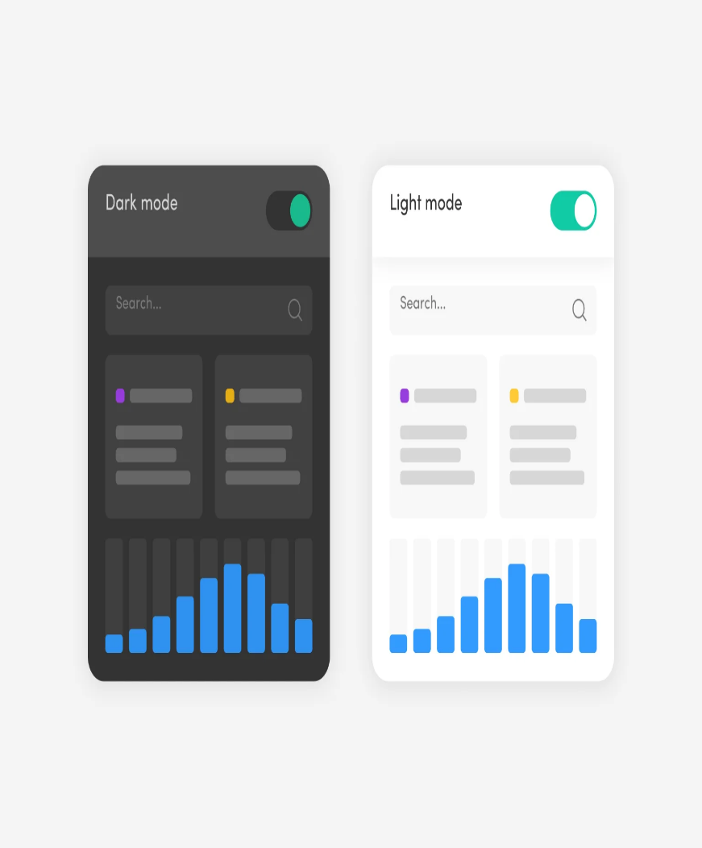
3.Dark/light mode
This feature is all about users experience and accessibility. It allows users to switch between a light colour scheme(light mode) and a dark scheme (dark mode) for the website interface.
Light mode-this a traditional website colour mode, typically featuring a white or light coloured background with a dark text.
Dark mode-this mode reverses the colour mode, using a dark or black background with light text. it's often preferred by users in low-light conditions as it reduce eye strain.
In summary, this feature improve the users experience by providing flexibility to individual preferences. It enhances readability, reduce eye strain and contributes to more comfortable and personalized browsing experience.
2/3/2025
5

Slide 7
•
This is feature crucial for ensuring a consistent
4.Responsive
and user-friendly experience across a wide range
of devices, from smartphones and tablets to
web design
laptops a desktop computers. It's about making
the website adapt dynamically the the screen size
and orientation of the device being used.
2/3/2025
6

Slide 8
How the program works
The application begins by prompting users to enter their login credentials. It then verifies the provided information against the database.
If the credentials are valid, the user is redirected to the dashboard.
The dashboard provides an overview of the user's financial data, divided into three main sections:
Expense Tracking – Users can record their expenses, which are stored in the database. The system categorizes expenses for better organization and analysis.
Income Tracking – Users can log their income, specifying sources or reasons, and the data is saved in the database
Overview & Analytics – This section visualizes the user’s financial activity, displaying expense categories and income sources. a weekly summary is presented as a pie chart to help users track their financial trends over time.
By integrating authentication, data management, and visualization, the app provides users with a comprehensive tool to monitor their financial health effectively.

Slide 9
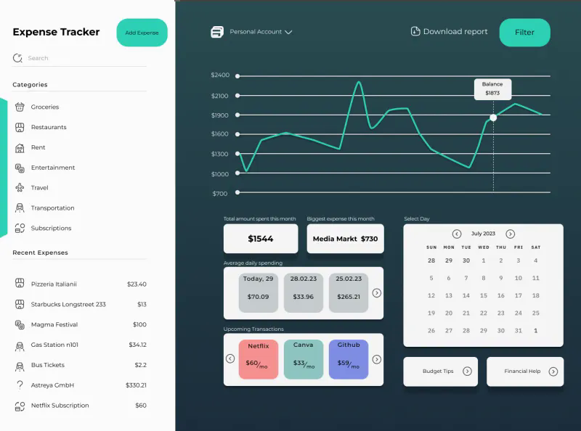
Applied Front end
HTML- which provides the structure of the pages; such as home page, signup page, expense & income page….and so on.
JavaScript- is used to add interactivity; such as form validation, chart generation, flash message …and so on.
CSS- used for styling the HTML elements, making the web pages visually appealing. controls the layout, colors, fonts, and spacing of the various elements on the page
2/3/2025
7

Slide 10
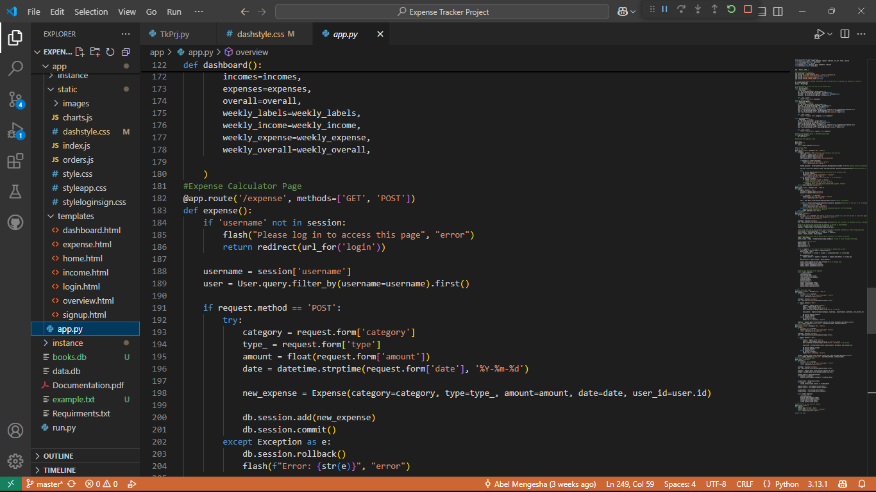
Applied Backend
Flask- Python-based micro-framework , used to define routes, handle HTTP requests, and render templates
SQL Alchemy- It’s a tool that makes it easier for Flask to work with a database, it provides an abstraction over raw SQL queries, so you work with Python objects instead of SQL code
ByCrypt- a password hashing library used to securely hash and check passwords in the application.
2/3/2025
8

Slide 11

Features to add in future
1.Voice input expense entry- allows users to record their expenses by speaking instead of typing them in manually. This feature will make it more convenient to use, and make it ideal for user’s who have mobility impairment.
2.Predictive budgeting and spending forecasts- use previous data to predict future spending patterns and create budgets. The app would suggest an estimated spending plan based on the user’s past behaviors, helping them plan their finances better.

Slide 12

Challenges Faced
During our time of developing this website we have faced many challenges which makes our time of working in this project difficult. Some of the challenges are:
1.Dificulty in understanding Front-end frameworks
-Modern web development often relies on JavaScript frameworks for building dynamic and interactive user interface. Having no background in this area makes the project difficult.
2.Struggling with Back-end development and data base design
Building the server-side logic for handling user authentication, storing expense data, and performing calculation requires back-end development skills and knowledge of data base design. Almost all of the group members are not familiar with such types of concept, which makes the work more harder.

Slide 13
cont.
3.Difficulty integrating Front-end and Back-end
This was the most challenging part of all the project. connecting the Front-end interface and Back-end application programming interface (API) to fetch and display data can be challenging. Understanding how to make API requests and handles is crucial.
12

Slide 14

How we
solve the
challenges
2/3/2025
13

Slide 15
During our time in working in this projects we have faced major problems, but the challenges don't stop us from working. We have solved these challenges using different methodologies. Some of the methods are:
To build the front-end and the back-end we have begin by learning the core concepts of HTML, CSS, data base, and JavaScript. To understand these concept, we have been following tutorials different YouTube sources, such as travers media(traversymedia.com), the net ninja(www.youtube.com/@NetNinja). freecodecamp.org, and programming with mosh(www.youtube.com/@programmingwithmosh)

